Slide 1
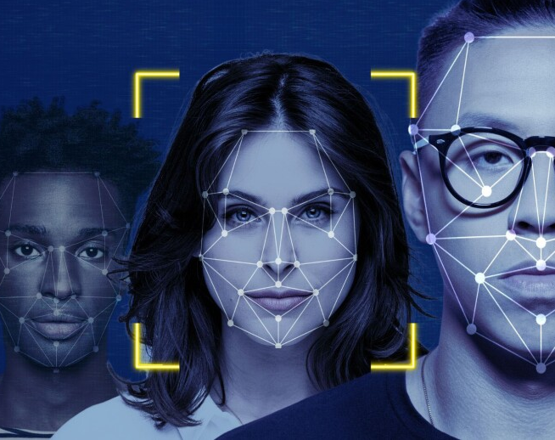
Face Verification Using HOG and LBP
Presented by-
Md Moyan Uddin (222901001)
Md mamun Ahmed (222901019)
Mohammad Shahariar Masud (222901008)

Slide 2

Agenda
Introduction
Project objective
Block Diagram
Tools used
Working principle
Implementation and result
Issue faced and future enhancement
Conclusion

Slide 3
Introduction
What is facial recognition system?
HOG and LBP
Widely used in security systems and smartphones.

Slide 4
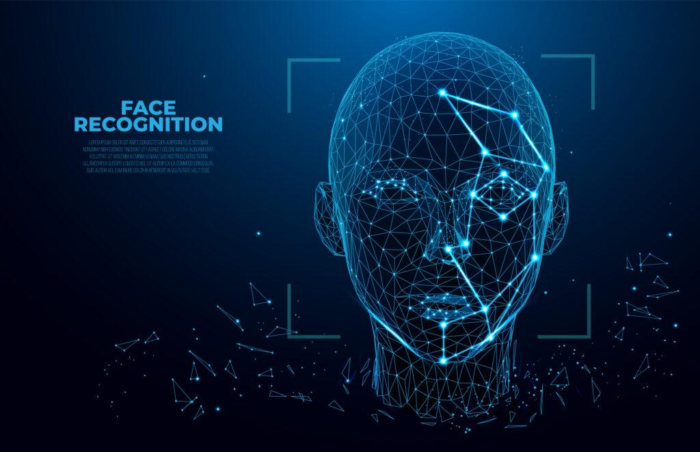
Project objective
To Build robust face detection using classical DSP and Computer vision method
Build an interactive GUI that integrates detection and matching

Slide 5
Block diagram
Input image
Preprocessing
Feature extraction
Display Result

Slide 6

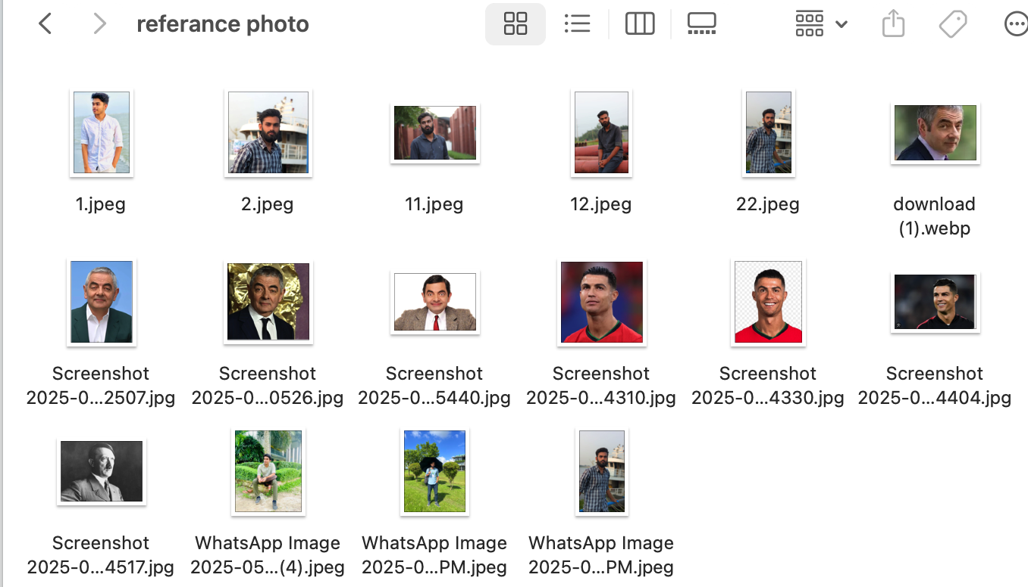
Tools used
MATLAB
Custom Image Dataset
Image Processing Libraries

Slide 7
Working principle
Face Detection
Region Localization and Cropping
Normalization and Enhancement
Result Display
Similarity scoring and matching
Feature extraction

Slide 8
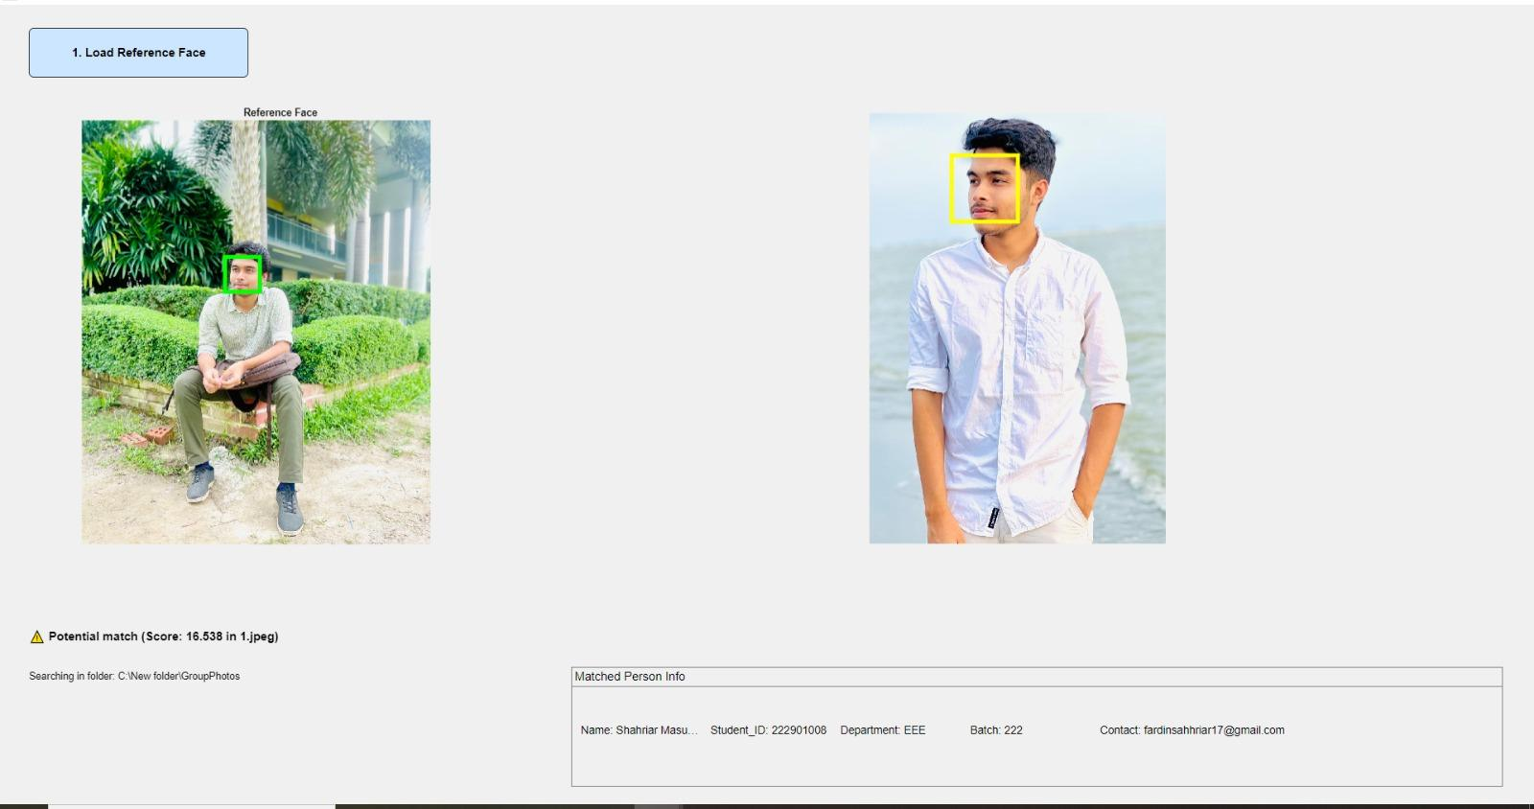
Implementation and result
Image loading
Face detection
Feature matching

Slide 9
Issue faced and future Enhancement
Inconsistent Face detection Across Images
False match in Crowded group photos
Low accuracy in profile or Rotated face
Integration of Deep learning for Feature Extraction
Multi face tracking and identification
Expression and Emotion recognition

Slide 10
Conclusion
In this project, we successfully designed and implemented a facial recognition system using image processing techniques in MATLAB as part of our Digital Signal Processing lab course. The system utilizes Histogram of Oriented Gradients (HOG) and Local Binary Patterns (LBP) for feature extraction and applies a similarity metric to match faces against a fixed dataset. A GUI was also developed to enhance user interaction and facilitate ease of use.

Slide 11
Thank you

